Slide 1
Virtualization Using Docker Containers: For creating reproducible environments and containerized applications
IA 697 Starred paper proposal
Srinath Reddy Meadusani
Committee members
Dr. Susantha Herath, Chair
Dr. Ezzat Kirmani
Dr. Kasi Balasubramanian
Spring 2018
03/16/2018
Notes:
Add NSF logo

Slide 2
Contents
Problem Statement
Introduction
Significance of the Problem
Objectives of the Research
Expected Outcomes
Literature review
Methodology
Work in progress
Timeline
References

Slide 3
1. Problem Statement
In today’s competitive environment using the available resources efficiently has become imperative for IT organizations.
The traditional virtualization techniques which are being used in past years, has shown some degradation in the performance of applications which are deployed on those virtual machines.
Data center size of these organizations have also been increasing because of these obsolete virtualizations techniques.

Slide 4
2. Introduction
In the history of computing Containers have unique recognition because of its importance in virtualization of infrastructure.
Containers run the user space on top of the operating system kernel unlike traditional Hypervisor virtualization where one or more independent machines run virtually on physical hardware via an intermediate layer
Docker is an open-source engine which was introduced by Docker Inc in 2013 under apache 2.0 license to create light weight containers.

Slide 5
Significance of the Problem
Significance of improving the performance of organizations operations by solving the problem statement has become an inevitable task.
There is an urgent need for these organizations to adapt new virtualization techniques to avoid the unnecessary overheads which are specified in the above problem statement.

Slide 6
Objectives of the Research
Primary objective of this study is to discuss the available alternative solutions for the specified problem statement.
Paper introduces a new virtualization technique using Docker containers which is as an alternative solution for the traditional Virtual Machines.
Security and performance of the applications running in the Containers and Virtual Machines and their resource utilization will be compared by the end of the study.

Slide 7
Expected Outcomes
By the end of this study the paper answers the following questions:
Why there is a need for virtualization of infrastructure in an organization?
What are the problems with existing virtualization techniques?
Why there is a need to use containerized virtualization?
How did these containers solve the overheads of an organization?
How secure and compatible are these Containers?

Slide 8
3. Literature Review
Background Related to the problem:
With virtualization, a company can have limitless access to the computing resources which improves operations speed and the business capabilities.
Virtual Machines using Hypervisors is one of the techniques to implement virtualization.
Most of the organizations used this method for the virtualization of their operations but the disadvantages of using this method have been widespread recently.

Slide 9
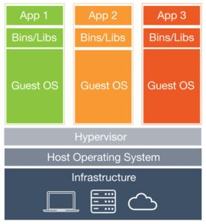
Literature Related to problem
Figure 1. Virtualization Using Virtual Machines (Wang, 2106)

Slide 10
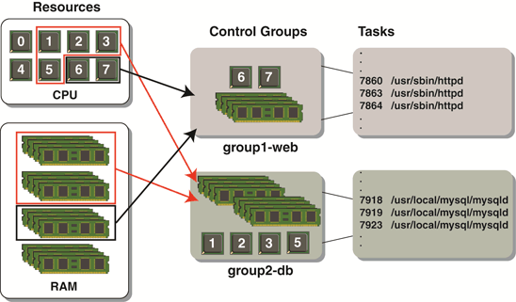
Literature Related to Problem(Cont…)
Linux Cgroups are developed by google, which governs the isolation and usage of system resources like CPU and memory usage for a group of processes.
Figure 2. Cgroups in Linux Containers (Henningsen, 2012)

Slide 11
Literature Related to Problem(Cont…)
While Cgroups provides isolation for group processes Namespaces deals with the isolation of resources for a single process.
There are six Namespaces currently, which are implemented Linux and the purpose of each Namespace is to provide an isolated environment for the processes and to implement lightweight containers in Linux distributed systems.
Mount Namespace isolate the set of file systems seen by the group of processes. Thus, the processes in each namespace will see distinct single directory hierarchies.

Slide 12
Literature Related to Problem(Cont…)
UTS Namespace gives separate domain name and host name to the processes by calling Sethostname( ) and setdomainname( ) systems calls.
IPC Namespace which stands for inter process communications isolates the certain inter process communication resources namely System V IPC and POSIX message queues.
Process ID Namespace isolates the process ID numbers, which means that processes in different namespaces can have same PID.

Slide 13
Literature Related to Problem(Cont…)
Network Namespace isolates the system resources associated with networking and With this namespace, each network can have its own IP addresses, IP route tables, Network devices and port numbers etc.
User Namespace allows the per-namespace mapping of user and group IDs and in containers, this namespace allows the users and groups to have certain privileges only inside that container.
Although Linux Containers which can solve most of our above-mentioned problem, they are not portable as they do not completely abstract the applications from lower level resources like networking, OS, and storage.

Slide 14
Literature Related to Methodology
To address the above mentioned issues Docker Inc has came up with a solution by introducing their new software in 2013 which is called Docker.
Docker is open source platform based on Linux Containers(LXC) which completely packages software applications
Dockers are created to provide lightweight and fast environment in which to run users code with efficient workflow and get that code from user’s laptop to test environment and then into production environment.

Slide 15
Literature Related to Methodology(Cont..)
The mission of Dockers is to provide following features:
1. Easy and lightweight way to model reality
2. Logical segregation of duties
3. Fast and efficient lifecycle development
With the above features, Dockers have resolved many challenges like Dependency Hell and imprecise documentations
Dockers containers also enhances the security features of application in two ways. One is by providing isolation between application and another is providing isolation between application and host system.

Slide 16
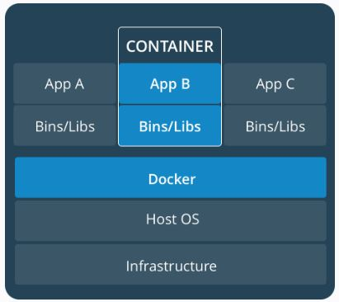
4. Methodology
The proposed study uses the mix of Qualitative and Quantitative approach as we are comparing the security features and resource utilization of containers and virtual machines.
Figure 3 Containerization using Dockers

Slide 17
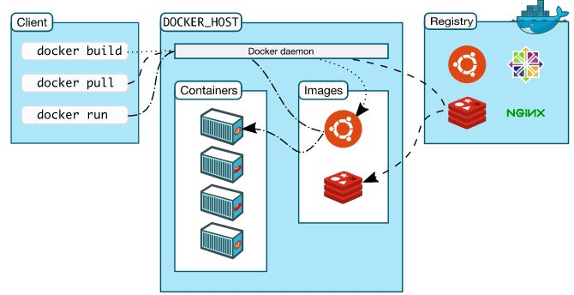
Methodology(Cont…)
The working methodology of Dockers can be understood by taking a deep dive at its architecture which is below:
Figure 5 Docker Architecture

Slide 18
Methodology(Cont…)
Using the Docker architecture methodology Docker engine will be installed on the local server and containers will be created.
Subsequently Applications will be deployed on the Containers which are created using Docker and also on Virtual Machines.
Performance and Resource utilization of this Applications will be analyzed by using Nagios tool and Splunk data analyzing Tool and applications security will be tested using AppDynamics.

Slide 19
Methodology( Cont…)
Hardware Requirement:
Resource | Minimum Required
Processor | Intel/AMD
Processor Type | 32/64 bit
Speed | 2 GHz
Disk Space | 100 GB
Software Requirement:
Tools | Docker
Hypervisor | VMware work station, Virtual Box
Database | MySQL
Language | HTML, CSS, Shell Scripting
Web Server | Apache 2

Slide 20
5. Implementation

Slide 21
6. Timeline
Start Date | End Date | Tasks | Duration (Days)
02/01/2017 | 02/11/2017 | Analysis of Virtual Machines | 11
02/12/2017 | 02/27/2017 | Study of Linux Containers | 15
03/01/2017 | 03/09/2017 | Implementing the Namespaces | 09
03/10/2017 | 03/16/2017 | Analysis of Docker | 06
03/17/2017 | 03/30/2017 | Implementation of Docker containers | 13
04/01/2017 | 04/08/2017 | Documentation for Proposal | 08
04/18/2017 | 04/20/2017 | Building and hosting applications in VMs | 12
05/01/2017 | 05/15/2017 | Building and hosting application in containers | 15
05/16/2017 | 05/25/2017 | Analyzing the performance in both VMs and containers | 09
05/26/2017 | 06/10/2017 | Deploying the containers in Cloud | 14
06/11/2017 | 07/05/2017 | Final Documentation for Defense | 25

Slide 22
7. References
[1] Ryan Chamberlain, Jennifer Schommer: “Using Docker to Support Reproducible Research”, 2014.
[2] Chao Zheng, Douglas Thain: “Integrating containers into workflows: A case study using Makeflow, Work Queue and Docker”, 2015.
[3] Carl Boettiger: “An introduction to Docker Reproducible Research with Examples from R Environment”, 2014.
[4] Charles Anderson: “Dockers in Software Engineering”, 2015.
[5]
http://www.infoworld.com/article/3072929/linux/containers-101-linux-containers-and-docker-explained.html
[6] James Turnbull: “The Docker Book”, 2014.

Slide 23
References( Cont…)
[7] Shrikrishna Holla: “Orchestrating Docker: Manage and Deploy Docker services to containerize applications efficiently”, 2015.
[8]
https://www.sdxcentral.com/cloud/containers/definitions/what-are-containers-like-docker-linux-containers/
[9] LeVeque R, Mitchell I: “Reproducible Research for Scientific Computing: Tools and Strategies for Changing the Culture”, 2012.
[10] I. Altintas, C. Berkley: “An extensible system for design and execution of scientific workflows in Scientific and Statistical Database Management”, 2004.

Slide 24


Slide 25


